Slide 1
Be A Ruby
CS 262 Team A
Matthew Walstra, Anne Gritter, and Adam Zentner

Slide 2
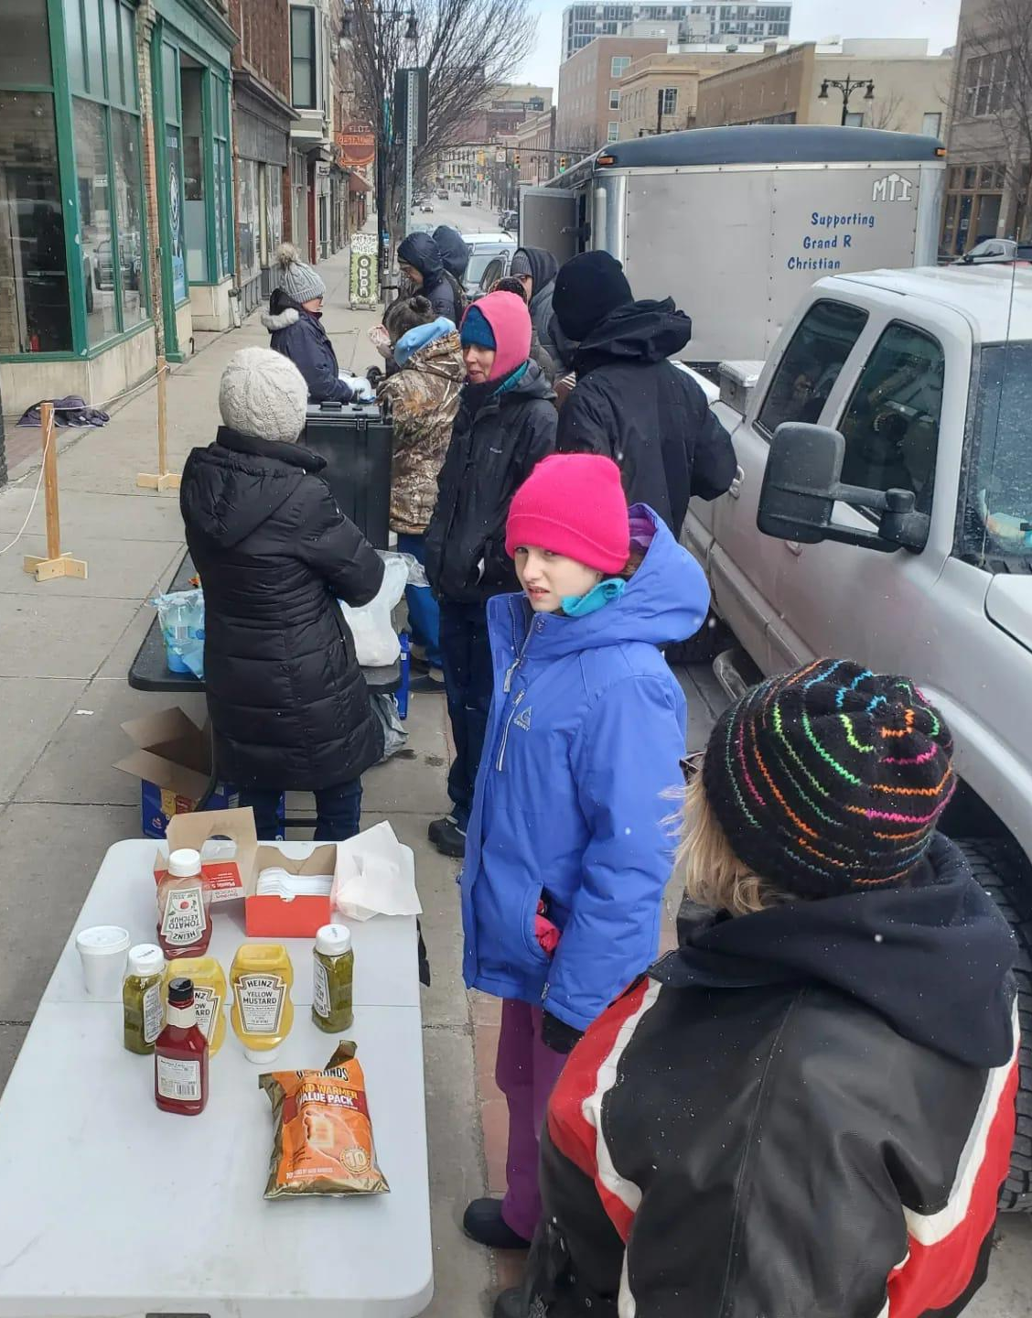
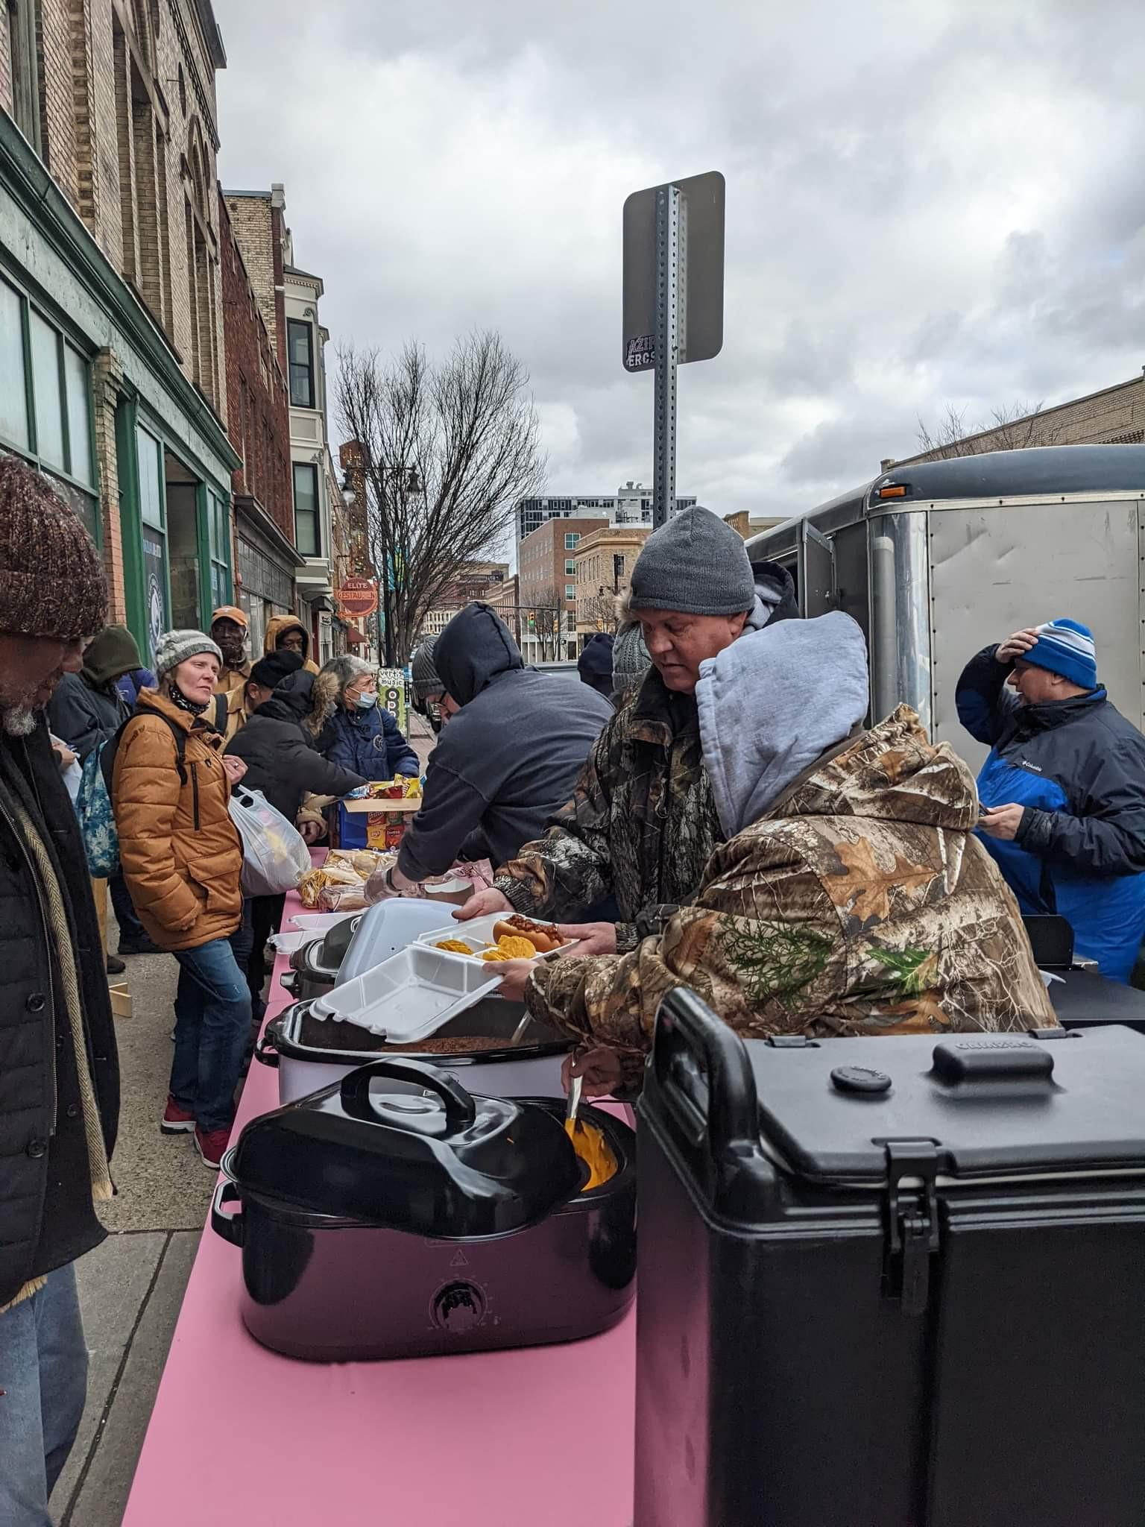
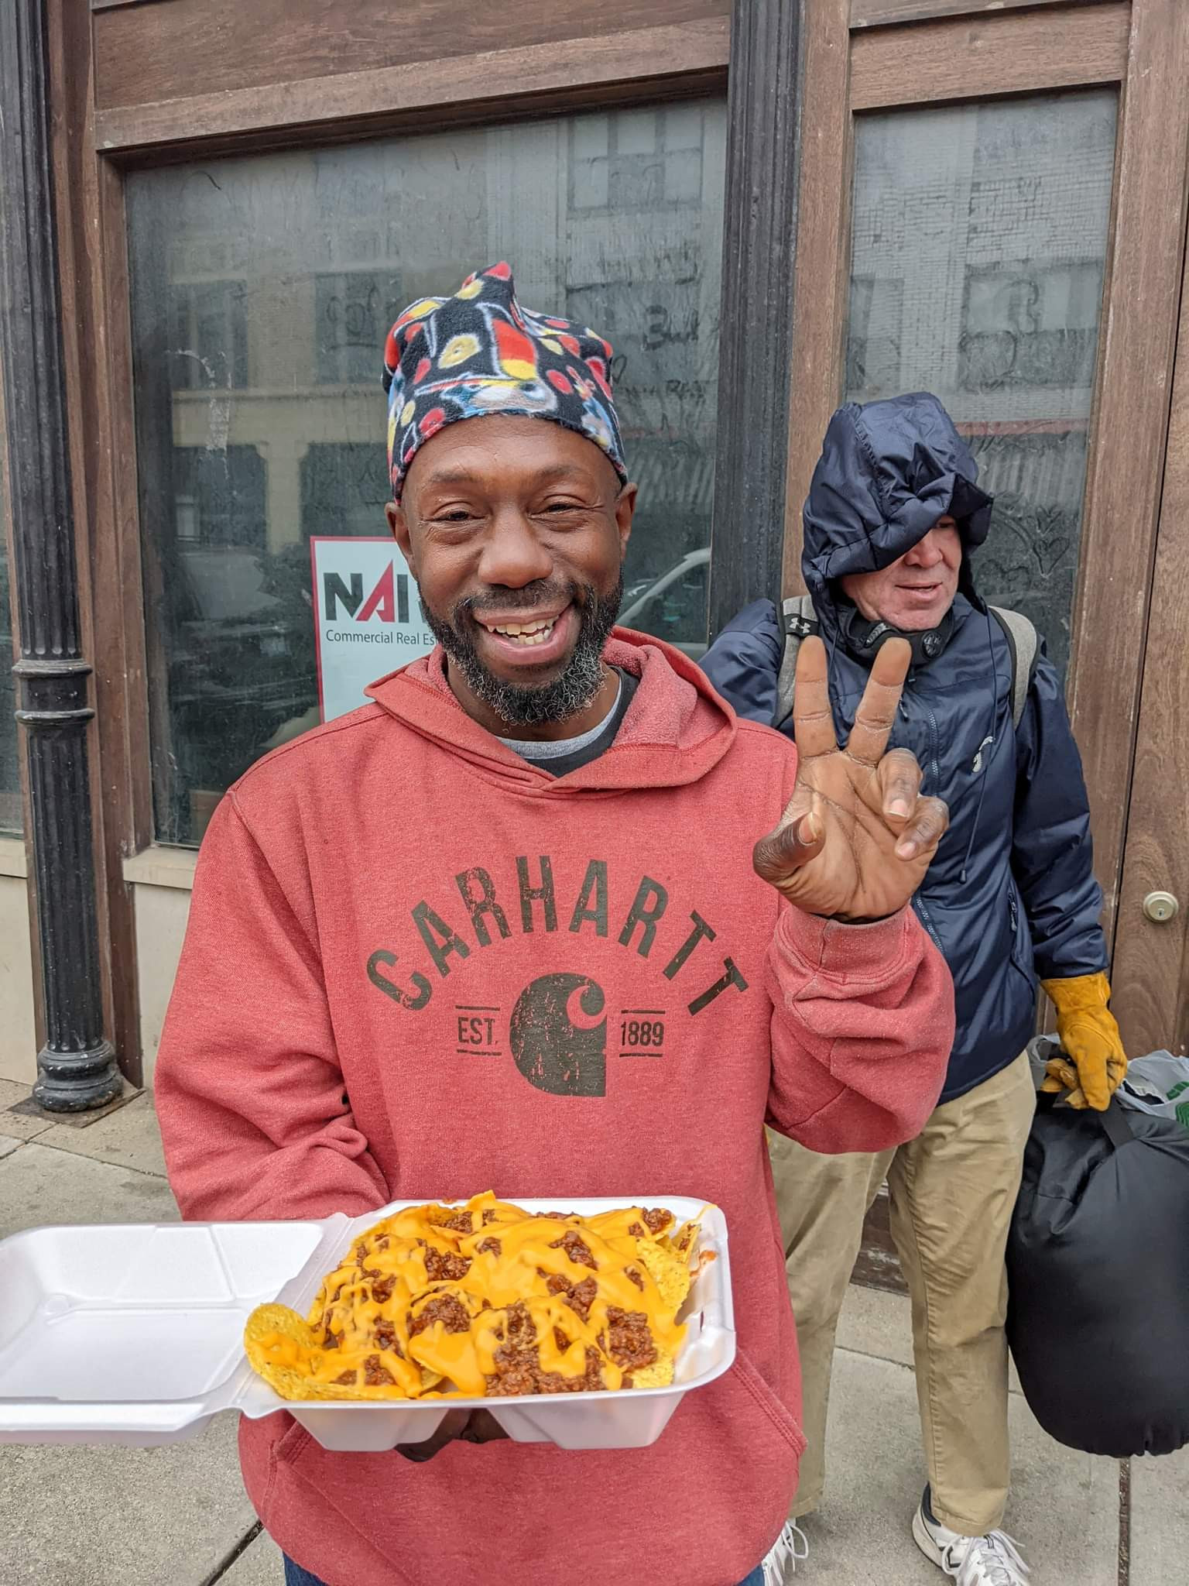
Vision Statement…
Notes:
Be A Ruby
Reason
Mission
Events
Problem
Tried apps
Our app

Slide 3
Demo
Site
Items list
Remove amount of item
Search
Help
Logout
Admin
Sign in
(user testing: strip whitespace)
(user testing: feedback on login button)
Site/admin difference
Change trailer
(user testing: exit when tap background)
Edit item
(user testing: larger button)
Help button
Create item
Delete item
Sort by low stock
Notifications
Volunteer
Register account
(user testing: feedback on login button)
Show Be A Ruby background
Go to website for donation

Slide 4
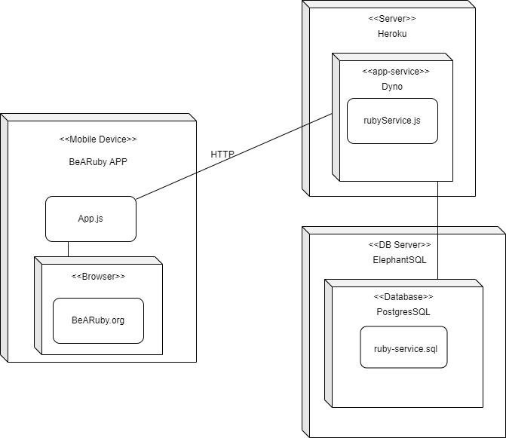
Deployment Diagram…

Slide 5
Strengths and Weaknesses…
Strengths:
Working main user stories
Simple user-friendly interface
Opportunity for expansion
Weaknesses + Future Improvements:
Need more feedback from Be A Ruby
Poor Styling
User Permissions
Creating new trailers
Upcoming Event Signups
Undo button
Improve password encryption

Slide 6
Postman’s Ethical Implications…
Technology is a tradeoff (1st idea):
Notifications before running out of items
Takes up volunteers’ time at events
Embedded ideas (3rd Idea):
Manipulating data instead of donations as gifts
Focus on accuracy and efficiency rather than compassion and service
Notes:
Technology is a tradeoff: efficient and nice to use, so it takes less time for volunteers
Embedded ideas: recognize the tendencies, limit scope of the app, so that most of the service they do is interactions between people
Reiterate Vision Statement: Thank you for feedback over the semester, App is part of a organization that improves the lives of people in downtown GR

Slide 7
Thank You

Slide 8
Questions?

